Slide 1
ATLANTIC TECHNOLOGICAL UNIVERSITY
Automated Liquid Cooling & Leak Detection Prototype for Server Racks
MSP430 environmental telemetry, PWM pump control, and instant resistive water spill protection
STUDENT
SUPERVISORS
MODULE
David Tapia Caicedo
Christopher Crossan & Adam Dunworth
L7 Project Presentation

Slide 2

01 · CONTEXT & MOTIVATION
The Server Cooling Dilemma
Continuous Power Waste
Liquid Leak Hazard
Fixed 100% Speed: Pumps run constantly even on cold racks.
Short-Circuit Risk: Water pipes sit next to live servers.
Mechanical Wear: Shortens pump lifespan significantly.
Slow Air Sensors: Room CRAC units dry air before RH rises.
Need PWM Control: Match flow rate to real-time heat load.
High Commercial Cost: Sensing cables cost hundreds of euros.

Slide 3
02 · PROJECT SCOPE
Core Engineering Objectives
3-Channel ADC Reading
32-Bit Integer Math
Sample TMP36, HIH-5030, and leak probe without crosstalk.
Eliminate float libraries to fit 16 KB Flash limit.
1 kHz Hardware PWM
Instant Spill Shutoff
Drive 5V water pump across 0%, 50%, and 100% duty cycles.
Cut motor power immediately upon conductive water contact.

Slide 4

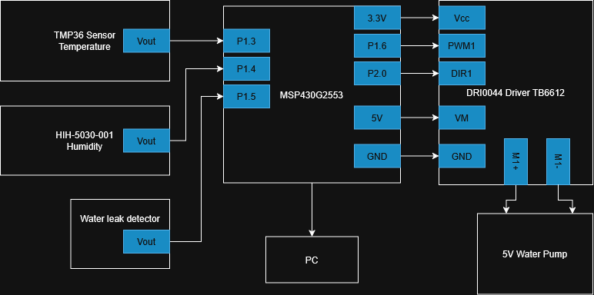
03 · SYSTEM OVERVIEW
Hardware Block Diagram & Pin Map
P1.1 & P1.2: 9600 baud UART to Tera Term.
P1.3 (INCH_3): TMP36 temperature input.
P1.4 (INCH_4): HIH-5030-001 humidity input.
P1.5 (INCH_5): 10 kΩ pull-down leak probe.
P1.6 & P2.0: 1 kHz PWM1 & DIR1 to DRI0044.

Slide 5
04 · HARDWARE SELECTION
Key Components & Prototype Cost (~45.40€)
Component | Operating Voltage | Role in Prototype | Cost
MSP-EXP430G2ET | 3.3 V Logic | 16-bit MCU, 10-bit SAR ADC, Timer_A, UART | 12.50€
TMP36GT9Z | 2.7 V – 5.5 V | Linear 10 mV/°C temperature sensor | 1.80€
HIH-5030-001 | 2.7 V – 5.5 V | Low-voltage analog relative humidity sensor | 9.50€
DRI0044 | 3.3 V Vcc / 5 V VM | TB6612FNG dual MOSFET H-bridge driver | 6.90€
Resistive Leak Probe | 3.3 V Divider | 10 kΩ pull-down resistor + bare wire electrodes | 0.20€
Pump, Fan, LCD & WiFi | 5 V / 3.3 V | Actuators and second-half expansion modules | 14.50€

Slide 6


05 · FIRMWARE ARCHITECTURE
Key C Firmware Solutions Solved in Lab
ADC10 Crosstalk Fix
32-Bit Long Casting
Hardware UART Polling
16-cycle sample-and-hold time prevents channel voltage ghosting.
Prevents 16-bit integer overflow during millivolt multiplication.
UCSWRST init sequence with UCA0TXIFG flag polling.

Slide 7

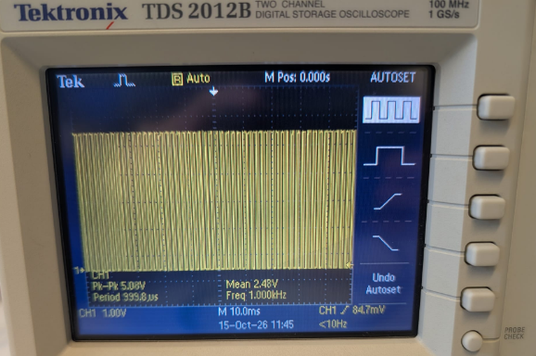
06 · HARDWARE VALIDATION
1 kHz PWM Verification at 50% Duty Cycle
2.48 V
MEAN OUTPUT (22°C – 25°C)
Frequency: Exact 1.000 kHz (999.8 µs).
Peak-to-Peak: 5.08 V across M1+/M1-.
Timer_A Config: TACCR0 = 999, TACCR1 = 500.

Slide 8

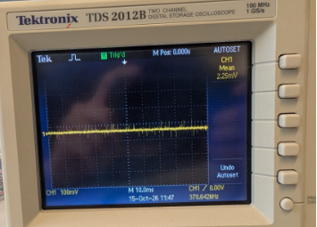
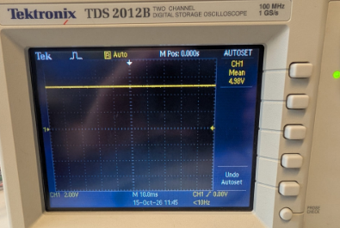
07 · THERMAL BOUNDARY STATES
Standby (0%) vs. Maximum Cooling (100%)
Below 22°C · Pump Off (0% Duty)
26°C & Above · Full Speed (100% Duty)
Mean output of 2.25 mV (flat 0 V baseline).
Mean output of 4.98 V DC (minimal MOSFET drop).

Slide 9
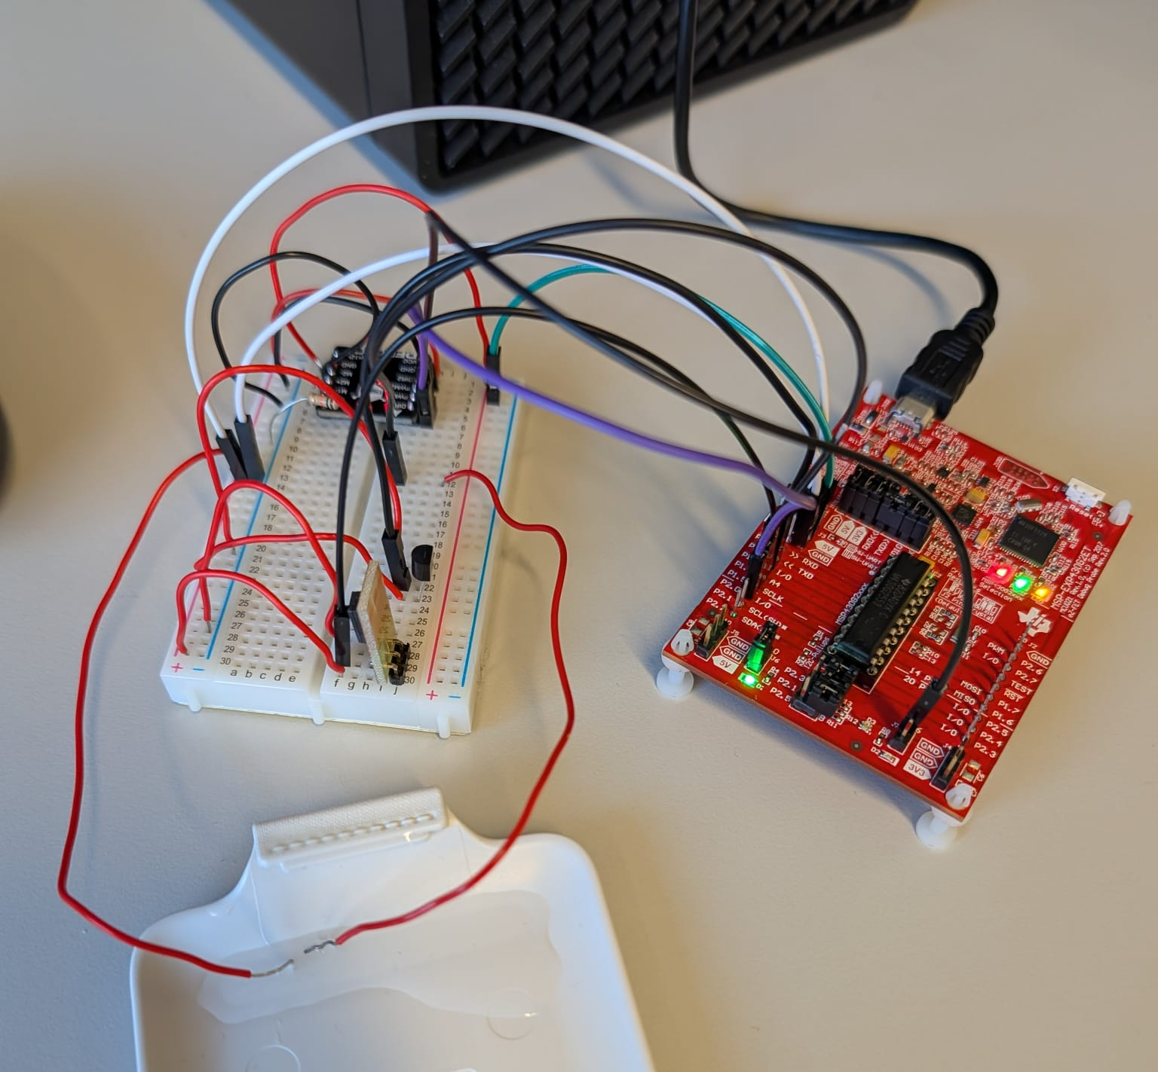
08 · LATEST LAB PROGRESS (WEEK 6)
Mounted Prototype & Emergency Leak Shutoff
Dry State (ADC < 150): 10 kΩ pull-down holds P1.5 at 0 V; normal thermal PWM active.
Wet Trigger (ADC > 150): Water bridges 3.3 V to P1.5 inside isolated plastic tray.
Hardware Override: Forces TACCR1 = 0 immediately regardless of temperature.
Visual & Serial Alarm: Lights Red LED (P1.0) and prints alert on Tera Term.

Slide 10
09 · SCHEDULE & ROADMAP
12-Week Project Timeline
WEEKS 1–4 · DONE
WEEKS 5–6 · DONE
WEEKS 7–8 · NEXT
WEEKS 9–12 · PLANNED
Core Sensors & PWM
Scope & Leak Probe
LCD Display
Wi-Fi & Water Loop
TMP36, HIH-5030, UART 9600 baud, and Timer_A setup.
DRI0044 validation, Interim Report, and P1.5 emergency stop.
4-bit parallel interface for standalone local readouts.
ESP8266 telemetry and physical 5V pump closed-loop test.

Slide 11
10 · LAB SAFETY & STANDARDS
Risk Mitigation & Compliance
Wet Zone
Open Loop Check
RoHS
Isolated plastic drip tray keeps water
20 cm away from LaunchPad USB.
Cold multimeter continuity test across
VM, VCC, and GND prevents shorts.
Lead-free compliant parts, WEEE disposal, and zero personal data.

Slide 12
L7 PROJECT · INTERIM PRESENTATION
Thank You
David Tapia Caicedo · L00213709 · Atlantic Technological University

